Slide 1
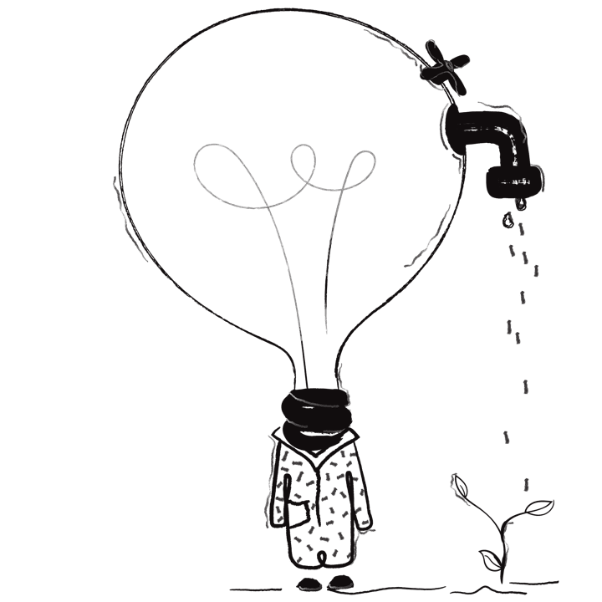
BG practicum
Program

Slide 2
Participants
The City of Belgrade and University of Belgrade;
Annual Protocol of cooperation;
Students’ practicum program in the City administration, City council, City Assembly, Urban municipalities, Public enterprises, Institutions of culture and Sport institutions founded by the City, as well as with other organizations of the City of Belgrade;

Slide 3
What, who, how
Creating opportunities for students to make connections between academic learning and practical application;
Final-year students and graduates;
100 students per year;
3 months program;
Public call for applications;
Applications submitted to the Center for Career Development and Student Counseling of the Belgrade University;

Slide 4
General application terms
Possibility of applying to more than one position;
Recommendation letter by the Faculty required;
English language knowledge and basic computer skills required;
Specific terms for candidates determined by the City organization units;
Possibility of transfer to another position, with student’s consent
Interviews with potential candidates, mentors;

Slide 5
How does it work
Selected candidates are invited to sign a practicum contract;
Certificate receiving ceremony upon the completion of the practicum;
The project was initiated in 2010 but temporarily suspended in 2020 and 2021 due to the epidemic situation;
In 2019 the program was completed by 63 students;
In 2022 the initial program was completed by 57 students and 15 of them wеre granted a three months extension;

Slide 6
Conclusion
Since the BG Practicum program was initiated more that 2000 students from 26 Faculties of Belgrade University have obtained their first professional experience in the Institutions founded by the City of Belgrade;
The Faculties of Belgrade University recognize BG practicum program as a significant extra curriculum activity that can be included in Diploma Supplement and for which additional ECTS (European Credit Transfer System) points can be awarded or as a mandatory student practicum which has been a part of academic program since the academic year 2013/2014.

Slide 7
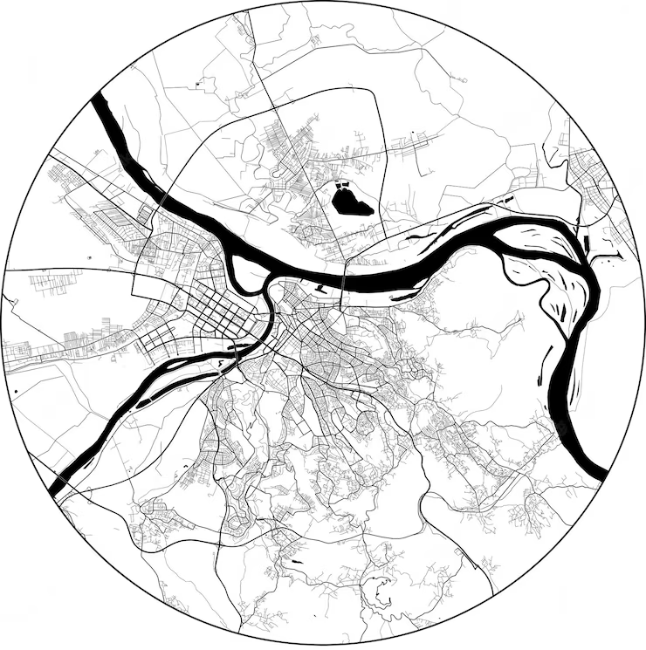
THANK YOU FOR YOUR ATTENTION

