Slide 1
WienBot
Smart City Assistant Vienna

Slide 2
WienBot
Smart City Assistant Vienna
Make information accessible for everyone through natural language

Slide 3
WienBot
Smart City Assistant Vienna
AI can speak and understand
but cannot answer (itself)

Slide 4
WienBot
Smart City Assistant Vienna
We have the best answers
for Vienna

Slide 5
WienBot
Smart City Assistant Vienna
WienBot is our local anwser to the voice assistants of the global players

Slide 6
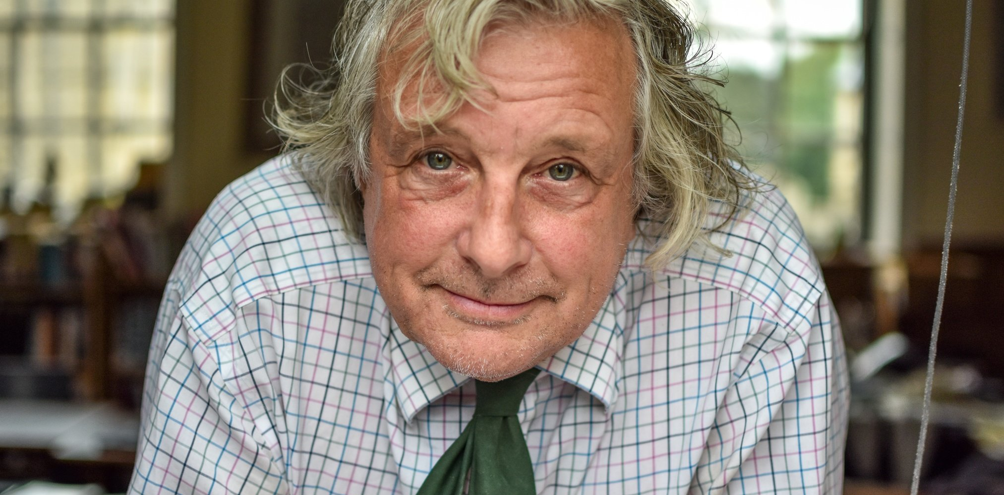
„Even I can find anything.“

