Slide 1

IT Solutions for the Municipality of Krakow
Jaroslaw Bulka
Advisor to the Mayor of Krakow for Digital Transformation

Slide 2


IT Department in numbers
210
MFP devices
270
Data transmission
devices
3,000 Users/workstations
130
Virtual servers
32 Locations
199
IT applications
60
Physical servers
73
Office Departments
558
Municipal units
700
Mobile phones

Slide 3
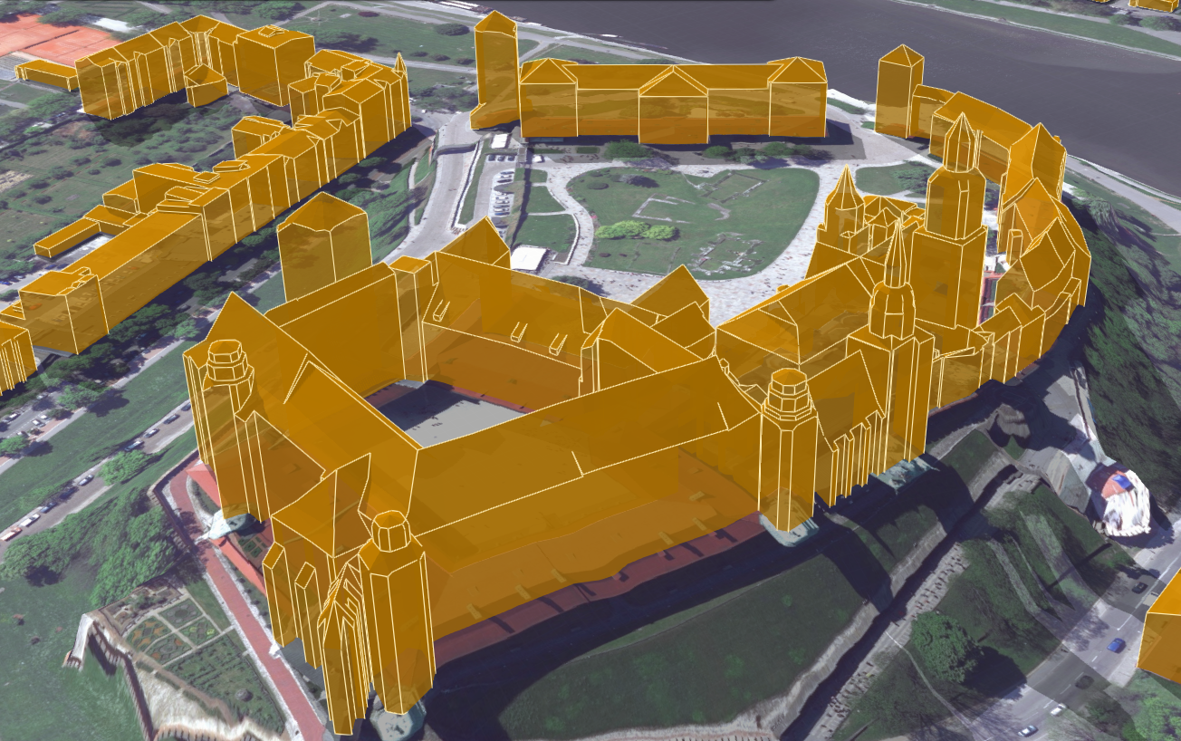
IT solutions in the Department of Geodesy
Open spatial data are three-dimensional building models developed as part of the CAPAP project run by the Head Office of Land Surveying and Cartography.
The first module contains 3D models of buildings in the LoD2 standard, taking into account the shapes. It is based on data from aerial laser scanning and contour of buildings from the BDOT10k database.
In the second 3D module an updated acoustic map of the city has been published. It presents the threat of noise in three dimensions, broken down into individual fragments of the building facades.

Slide 4
Public Information Bulletin (BIP) of the Municipality of Krakow
One of the largest portals of this type in Poland. Over 400 bulletins of municipal organizational units and other entities: 1500 operators and over 430,000 views a day.
It provides nearly 1,000,000 objects with public information about:
• city authorities
• operating rules
• finance and property of the municipality
• authorities policies
• public data
• municipal organizational units
• optional modules (elections)

Slide 5
Electronic Communication and Services (EKO) – a public services project
Enterprise Service Bus
Multifunctional customer account
E- documentation System
IT Service Center
Strategy and catalog of services
Open data
Reference databases - people
Portal of e-services
Reference databases - immovables
Ekstranet
Notes:
Moduły EKO: 1. SEOD (E- documentation System) 2. Szyna danych (Enterprise Service Bus) 3. Multifunkcjonalne konto klienta (Multifunctional customer account) 4. Strategia i katalog usług (Strategy and catalog of services) 5. COI ( IT Service Center) 6. Portal e-usług (Portal of e-services) 7. Otwarte dane (Open data) 8a. Bazy referencyjne – osoby (Reference databases - people) 8b.Bazy referencyjne – nieruchomości (Reference databases - immovables) 9. Ekstranet

Slide 6
Electronic Communication and Services (EKO) – a public services project
E- documentation System
Enterprise Service Bus
Multifunctional customer account
Strategy and catalog of services
IT Service Center
Provision of IT support services through services and implementation of IT and telecommunications standards for the Municipality of Krakow and Municipal units, as well as supporting the development and access to telecommunications infrastructure.
Supporting processes
E-documentation and processing of cases using workflow mechanisms (Workflow)
Exchange of documents and information with IT systems (internal and external) through integration with Enterprise Service Bus
Audit logs
Authorization management
Catalog of shared services (interfaces)
Service management module
Service operation logs
A standard developed for applications using services via a Enterprise Service Bus
Service:
provided by the Enterprise Service Bus
enabling integration within service applications
providing a unified way of logging external clients that supports different levels of authentication
integrated with the reference database of people
ready for integration with other services / applications via the Enterprise Service Bus
List of public services along with a service management strategy
List of public services in terms of the possibility of providing them electronically
Plan for transformation and development of services along with a strategy for managing them
Notes:
Moduły EKO: 1. SEOD (E- documentation System) 2. Szyna danych (Enterprise Service Bus) 3. Multifunkcjonalne konto klienta (Multifunctional customer account) 4. Strategia i katalog usług (Strategy and catalog of services) 5. COI ( IT Service Center) 6. Portal e-usług (Portal of e-services) 7. Otwarte dane (Open data) 8a. Bazy referencyjne – osoby (Reference databases - people) 8b.Bazy referencyjne – nieruchomości (Reference databases - immovables) 9. Ekstranet

Slide 7
Electronic Communication and Services (EKO) – a public services project
Portal of e-services
Open data
Reference databases - people
Ekstranet
Increasing the level of access to public information through access to current, complete and transparent data in an automated manner.
Orderly, reference database of people made available by the Enterprise Service Bus.
Reference databases - immovables
Portal managed by using a Content Management System (CMS).
Enabling the implementation of tasks related to the provision of services provided electronically via the Internet for Clients through, among others, the Public Services Catalog.
Developed dictionary data for use in other reference databases.
Orderly, reference estate database connected to the reference people database and dictionary data, provided by the Enterprise Service Bus.
Portal enabling information exchange and sharing resources between units of the Municipality of Krakow.
The Integrated Information Service will be built of two main modules - Intranet and Extranet
Notes:
Moduły EKO: 1. SEOD (E- documentation System) 2. Szyna danych (Enterprise Service Bus) 3. Multifunkcjonalne konto klienta (Multifunctional customer account) 4. Strategia i katalog usług (Strategy and catalog of services) 5. COI ( IT Service Center) 6. Portal e-usług (Portal of e-services) 7. Otwarte dane (Open data) 8a. Bazy referencyjne – osoby (Reference databases - people) 8b.Bazy referencyjne – nieruchomości (Reference databases - immovables) 9. Ekstranet

Slide 8
Modernization or replacement?
Service Strategy - a key document describing the principles of providing services by Municipality of Krakow.
Includes the principles of service portfolio management, including their prioritization, sharing, maintenance, modification and incident management related to the implementation of
e-services.
Defines the principle of the service model.

Slide 9

Service development - Smart City
For a resident of Krakow
Current information about urban space (including processes and events taking place in the city)
Mobile access to selected services
Infrastructure supporting ecomobility
Preventive healthcare
For the Municipality of Krakow
Modern management tools (integration and presentation of data from multiple sources, process optimization)
Urban transport management
Media management
Activities supporting the creation of pro-health behaviors
The data virtualization environment planned for implementation, along with their visualization for the needs of city and city management

Slide 10
Thank you for your attention

