Slide 1
From E-Government to Digitization
City of
Vienna
Robin Heilig
wien digital/PACE

Slide 2
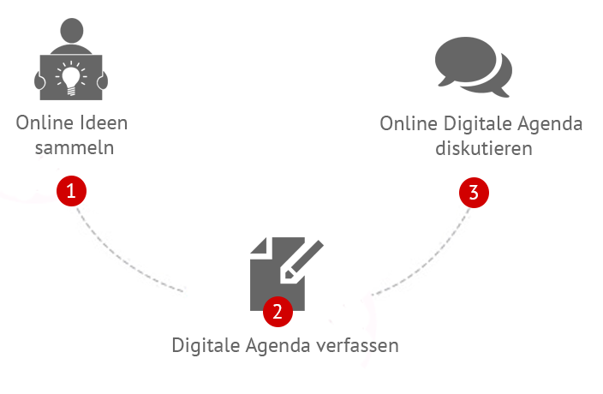
Digitale Agenda Wien

Slide 3
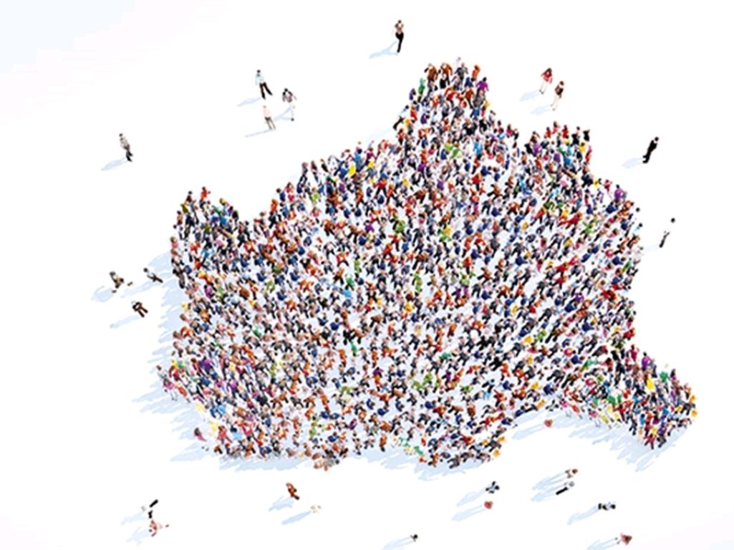
together

Slide 4
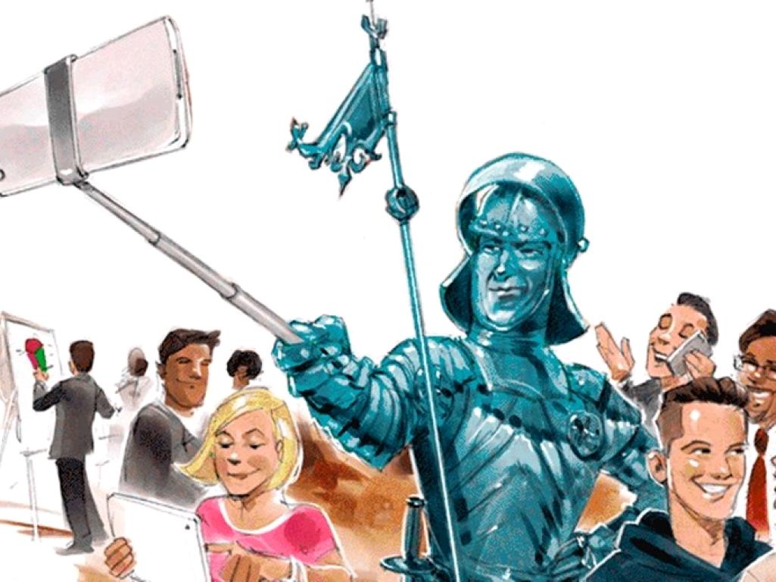
OpenSpace Day

Slide 5
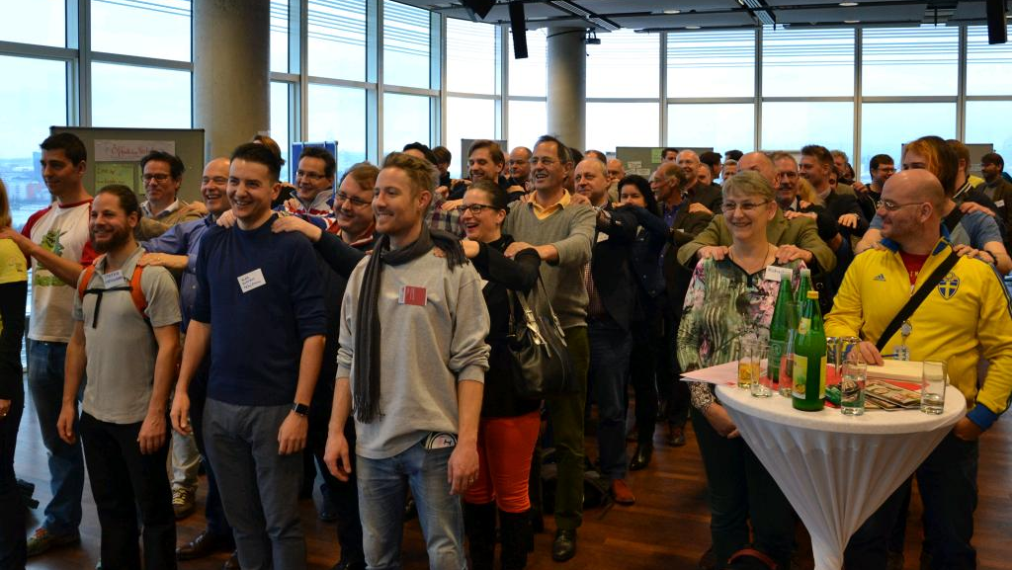

Slide 6
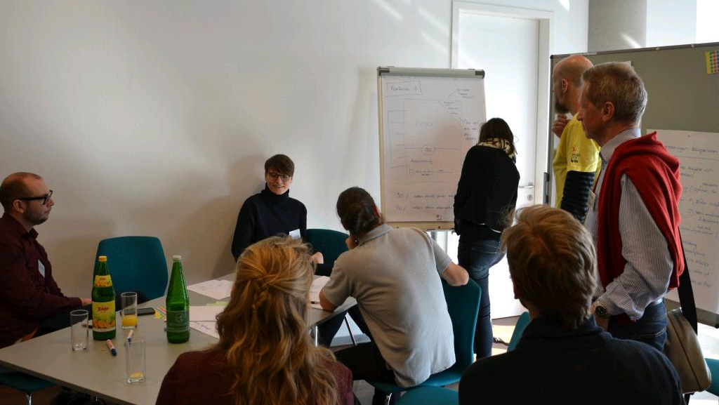

Slide 7
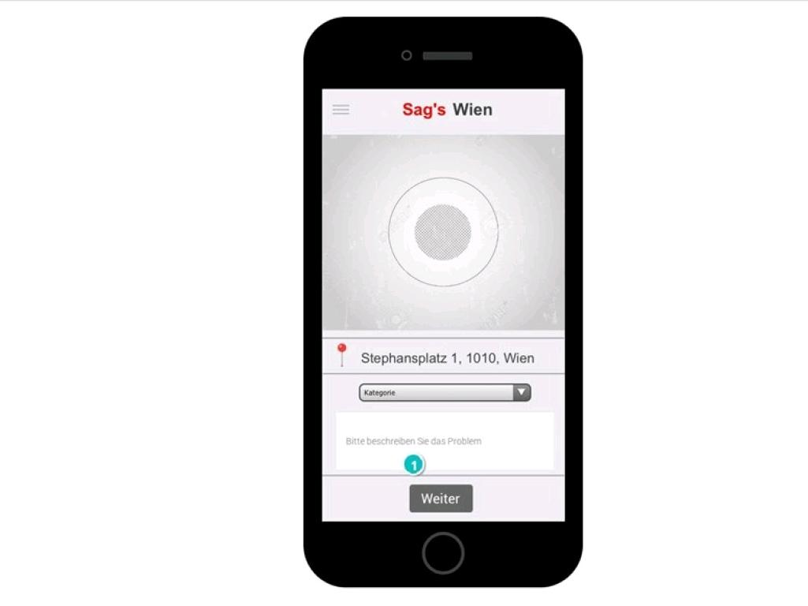

Slide 8
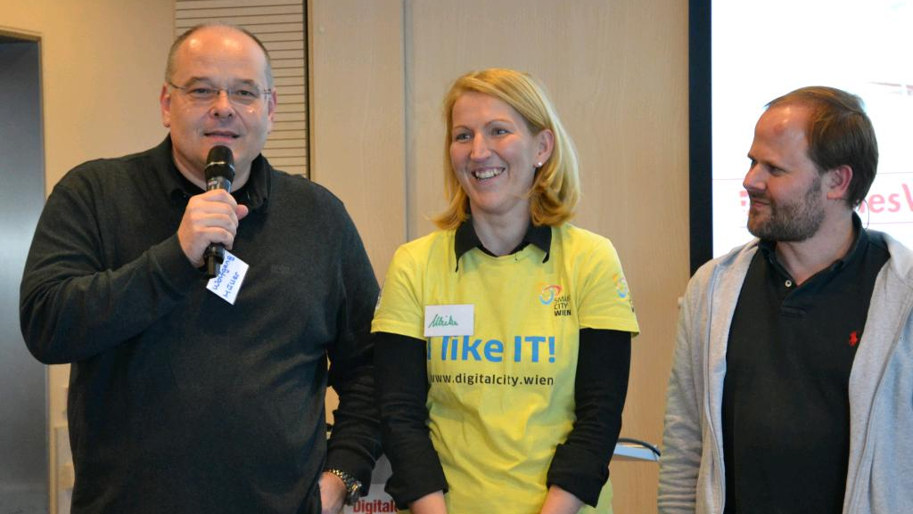

Slide 9
Innovationteam for
digitization of Vienna

Slide 11
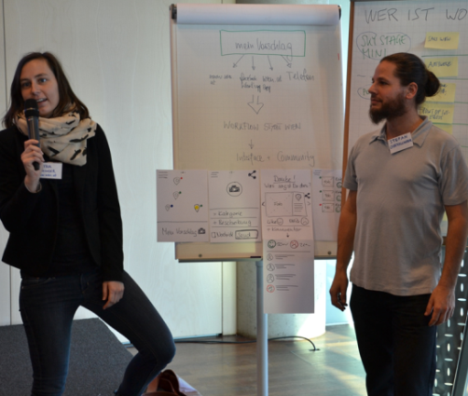
co-create!
Citizens
Politics
City Council
Districts

Slide 12
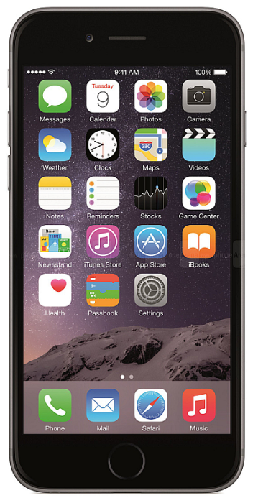
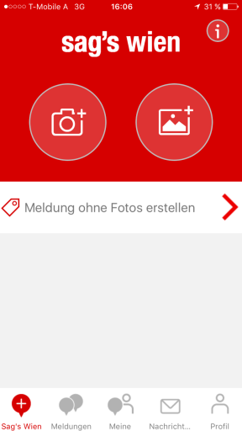
simplify!
NO registration
Send within 15-30 seconds
Automat. Push-Updates
Bidirectional
communication

Slide 13
43.900
DOWNLOADS

Slide 14
48.300
REPORTS

Slide 15
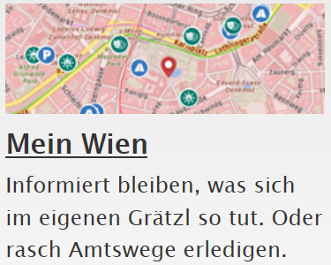
citizen‘s portal

Slide 16
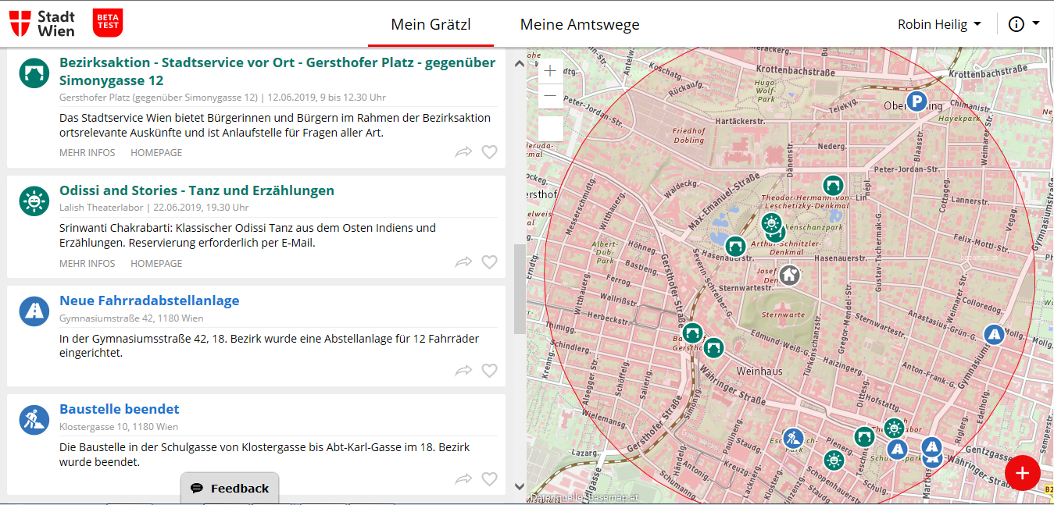
personalize!

Slide 17
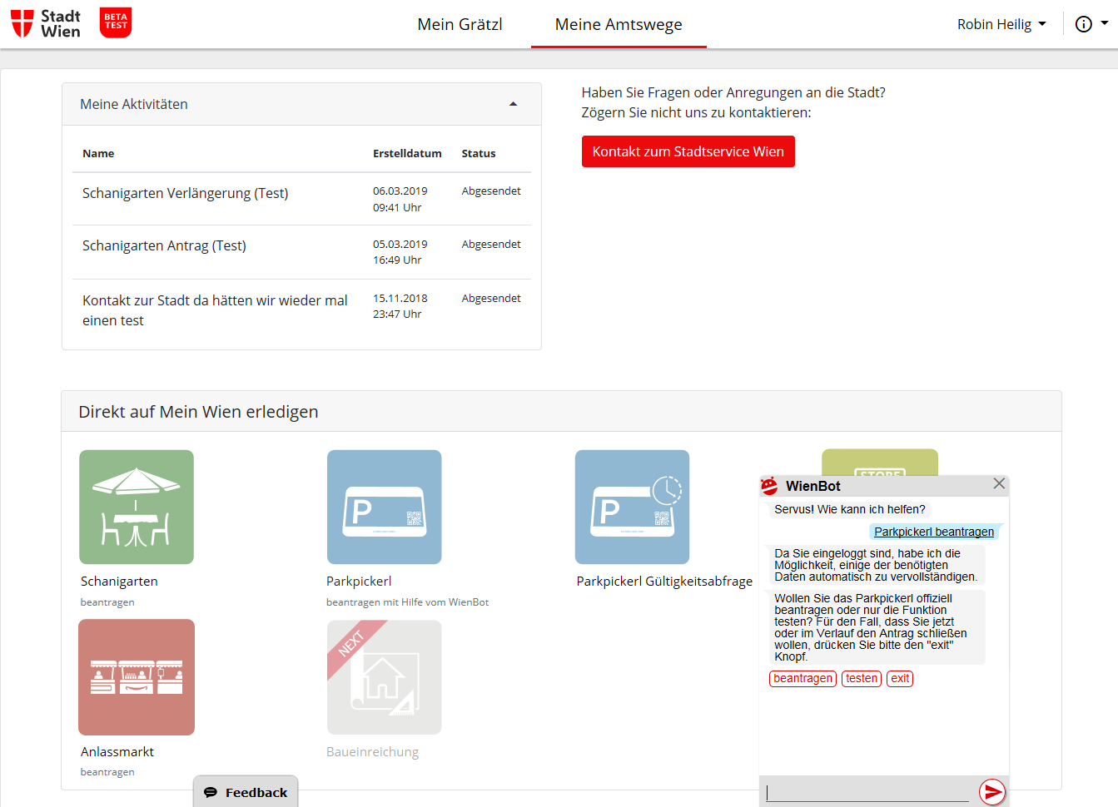
rethink!
logged in
my activities
direct contact
WienBot
direct feedback

Slide 18
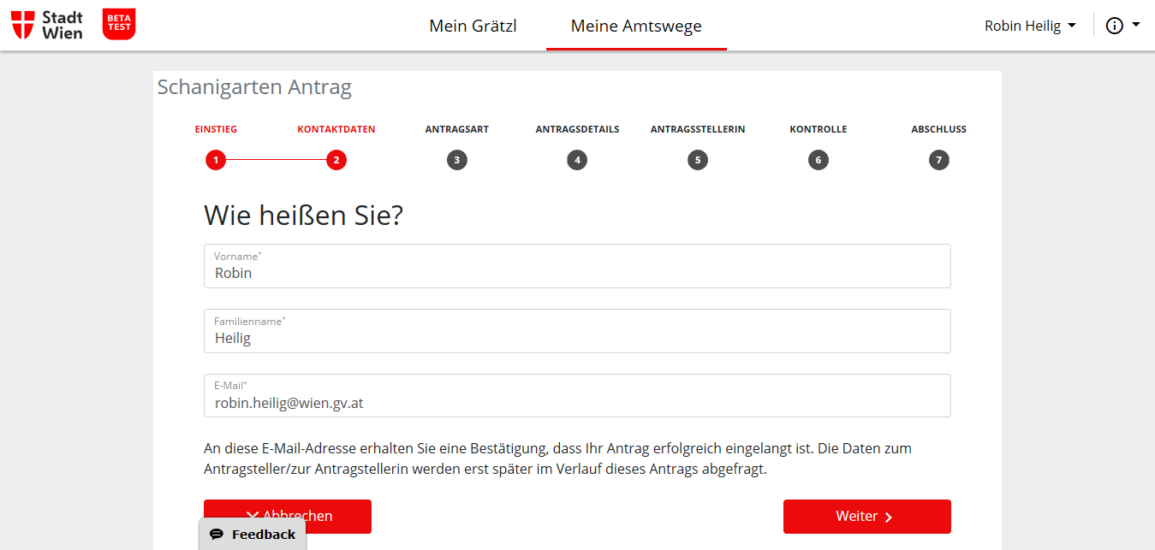
rethink!

Slide 19
envision!

Slide 20
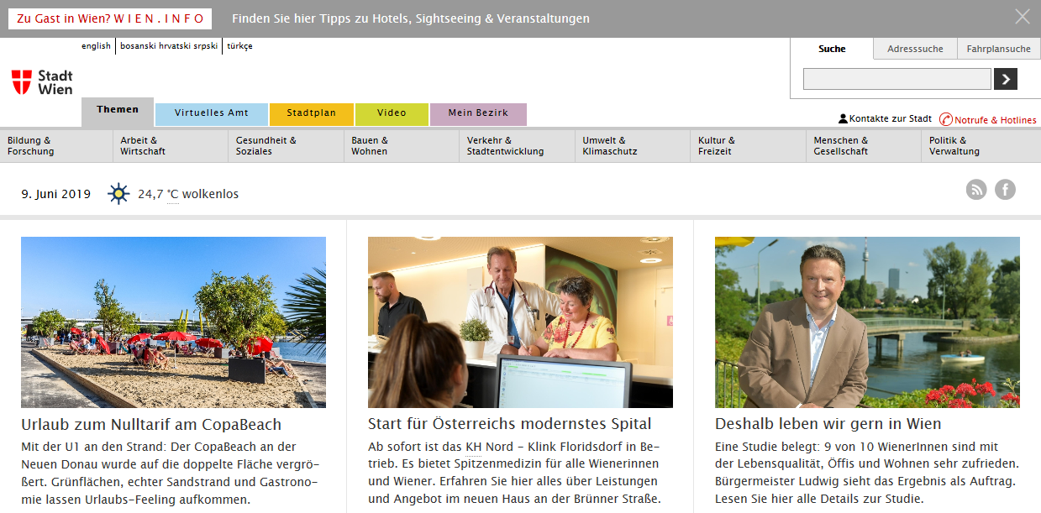
integrate!
City Content
Citizen‘s Data

Slide 21
collaborate!
public administrations
universities
cities
companies
External service providers
innovation hubs
start ups
research institutes

