Slide 1
Digital City Vienna
19.6.2019
Mag.a Ulrike Huemer
CIO City of Vienna

Slide 2
Mag.ª Ulrike Huemer
Chief Information Officer (CIO)
City of Vienna – Chief Executive Office
Executive Group for Organisation, Safety and Security
Process Management and ICT Strategy

Slide 3
Key data of Vienna
City, state and municipality
415 km² - 23 districts
Population: 1.868.000
82,000 city administration staff
30,000 civil servants
13.9 billion Euro budget
220,000 city-owned appartements
400 primary & vocational schools
12 hospitals
9000 hospital beds

Slide 4
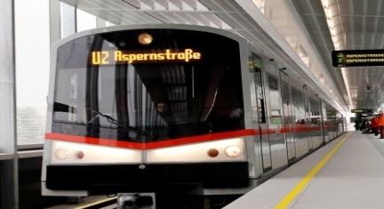
Ranking
1st place
best liveable city
1st place
Smart city (by Roland Berger)

Slide 5
Digital Agenda Vienna
Digital Agenda Vienna
Digital Community Services
Internet of Things – IoT Strategy
Tell it Vienna App
ChatBot
Data Excellence
Open Government Data
Sharing Public Space
Blockchain (PoC)

Slide 6
Principles of Vienna
Trust & security
Transparency, openness & participation
Inclusion, solidarity & social sustainability
Gender equality
Citizen orientation
Strengthening the business location
Consolidation
Innovation
Flexibility & learning

Slide 7
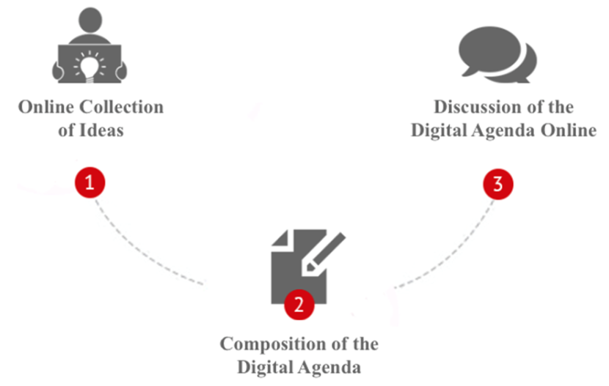
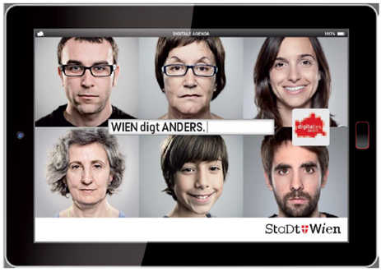
PaRTICIPATION PROCESS
active involvement of citizens
creative & innovative solutions
modern & service-oriented administration

Slide 8
KEY-QuESTIONS
What should the future design of the City of Vienna’s ICT infrastructure be like?
How can ICT be used to develop Vienna’s position as a business location?
How can the City of Vienna benefit from ICT to better support its customers in all stages of life?
How is ICT changing the way administrative authorities work in the future?
What reservations do you have about an increasing digitalisation of the Vienna City Administration?

Slide 9
Digital Community Services
Digital Agenda Vienna
Digital Community Services
Internet of Things – IoT Strategy
Tell it Vienna App
ChatBot
Data Excellence
Open Government Data
Sharing Public Space
Blockchain (PoC)

Slide 10
Digital Community Services
Vienna as a proactive City
e.g. reminder for citizens to renew passport, services within a few clicks
New understanding of services
It shouldn‘t feel like an official procedure.
e.g. individualized offers, based on my interests (Amazon principle)
Rethinking E-Government
no more forms or documents
citizen-oriented language
ChatBot (WienBOT) and smart apps offer help, and guide through the processes
Digital Neighborhood Services
tipps and information based on my residential surroundings
networking with neighbors
Official procedures are digital and disruptiv
citizen-oriented and simplified
avoiding printing and scanning documents
entirely digital processes

Slide 11
D R A F T FOR PLATTFORM

Slide 12
Wien.at Live App
Map of Vienna
Online & Offline
Free WIFI spots
QR-Code Reader
Realtime Information
Interruption of public transport
Krises/Security Issus
Events
Weather warning
Hotlines

Slide 13
Mobility – Wiener Linien
WienMobil app
Route planning & ticket service
Combines various forms of mobility (public transport, carsharing, bike, taxi, walking)
Multy Modal
Information source: environmental impact, construction work or delay

Slide 14
Internet of Things – IoT Strategy
Digital Agenda Vienna
Digital Community Services
Internet of Things – IoT Strategy
Tell it Vienna App
ChatBot
Data Excellence
Open Government Data
Sharing Public Space
Blockchain (PoC)

Slide 15
IoT-Projects
WAALTeR means “Ambient Assisted Living“
fall detection
measurement of blood pressure
blood sugar data
1,200 traffic light systems with around 10,000 weather and environmental sensors
IoT Strategy Paper (2018)

Slide 16
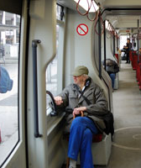
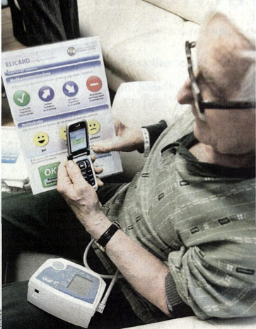
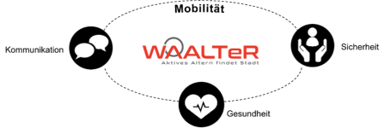
WAALTeR - Wiener Active Assisted Living TestRegion
Research project
140 Vienna households
Example Digitalisation is relevant for all generations
How does the provision of AALs services and technologies influences the users’ mobility, social integration, security and health status?
IoT/smart home AAL services and technologies:
fall detection in the interior
measurement of blood pressure
blood sugar data, etc.

Slide 17
Tell it Vienna App
Digital Agenda Vienna
Digital Community Services
Internet of Things – IoT Strategy
Tell it Vienna App
ChatBot
Data Excellence
Open Government Data
Sharing Public Space
Blockchain (PoC)

Slide 18
Government policy statement
With a new citizen app the people in Vienna should be able to send a message about a disruption or a defect at any time, anywhere, directly and intuitively. The message will be processed as fast as possible and of course also fixed

Slide 19
Report disruption or defect
Online since February 2017
Easy & fast handling (7 clicks, 30 seconds, without registration)
Automatical push-updates
Interaction: messages from other citizens are public
28.680 downloads
21.717 messages

Slide 20
Graphical editing
GPS-positioning via basemap or convenient address entering with interactive map of the city
The user can also see other messages from other citizens in the neighbourhood

Slide 21
ChatBot
Digital Agenda Vienna
Digital Community Services
Internet of Things – IoT Strategy
Tell it Vienna App
ChatBot
Data Excellence
Open Government Data
Sharing Public Space
Blockchain (PoC)

Slide 22
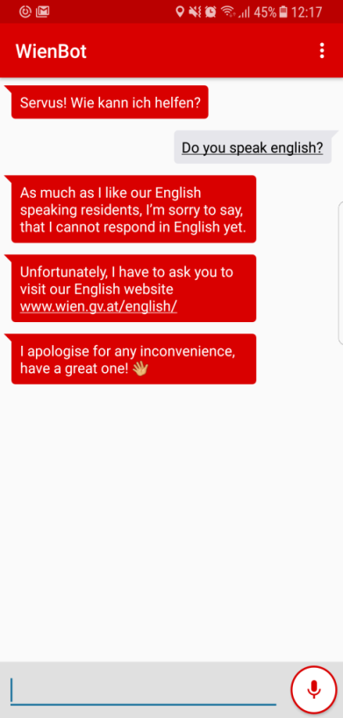
Vienna‘s Chatbot
WienBot
Official city of Vienna chatbot
for all kinds of service requests
Currently not in English, but will be in the next year!

Slide 23
Data Excellence
Digital Agenda Vienna
Digital Community Services
Internet of Things – IoT Strategy
Tell it Vienna App
ChatBot
Data Excellence
Open Government Data
Sharing Public Space
Blockchain (PoC)

Slide 24
Vision
City of Vienna provides reliable information and data, as a core value of a future administration.
In this way we create a significant value for the citizens, economy and science and
we contribute to an efficient fulfilment of our duties.

Slide 25
Data strategy
Data Excellence (DX)
Implementation for a prompt contribution of reliable administrative data, in an appropriate quality
Data Governance
Recommendations regarding regulations, organisation, processes, data-architectur and technology, to achieve Data Governance goals
Data Quality Management (DQM)
Measures for organisational, methodological, conceptual und technological implementation
Data Excellence
Data Governance
Data Quality Management

Slide 26
Open Government Data
Digital Agenda Vienna
Digital Community Services
Internet of Things – IoT Strategy
Tell it Vienna App
ChatBot
Data Excellence
Open Government Data
Sharing Public Space
Blockchain (PoC)

Slide 27
Open Government Goals
Citizen participation
Business & research
new apps
Administration
data use
consistent processes
commercial exploitation
no media disruption
strengthening the business location
decision making-processes
transparency
cooperation
data governance

Slide 28
Low-threshold Conditions
Only mentioning the name of the owner

Slide 29
10 Critical Success Factors
Political backing
No personal data & no data of critical infrastructure
Data of quality content by usage
Easy integration
Keep up to date
Publishing four times a year
Platform for community and developers
Free of charge – also for commercial utilization
One licence for Austria
Involvement of Universitys

Slide 30
beneficiaries
Economy
OGD is a further resource of valuable data
Science and research
Additional resource for statistical analysis
Journalism
Potencial for „revealing“
Developing
Experimenting with new sets of data
On average it takes 68,6 hours per app
Approx. 1,000.000,-- Euro added value for Vienna*
* 68,6 hours x 190 apps x € 80,-- developers rate = € 1,042.720,--
Added value is not to equal to value, as in the course of bidding procedures multiple developements would not be sponsored and value would have to be proven by utilization. Furthermore would requirementsdocumentation, quality assurance and testing create additional costs.

Slide 31
Top Data Sets
Statistics
Geo
Transportation
Urban Planning
Energy
Environment

Slide 32
Apps / Datasets
329
Datasets
Mag.a Ulrike Huemer
CIO City of Vienna

Slide 33
Sharing Public Space
Digital Agenda Vienna
Digital Community Services
Internet of Things – IoT Strategy
Tell it Vienna App
ChatBot
Data Excellence
Open Government Data
Sharing Public Space
Blockchain (PoC)

Slide 34
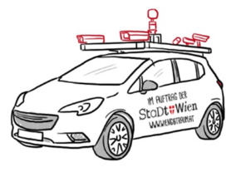
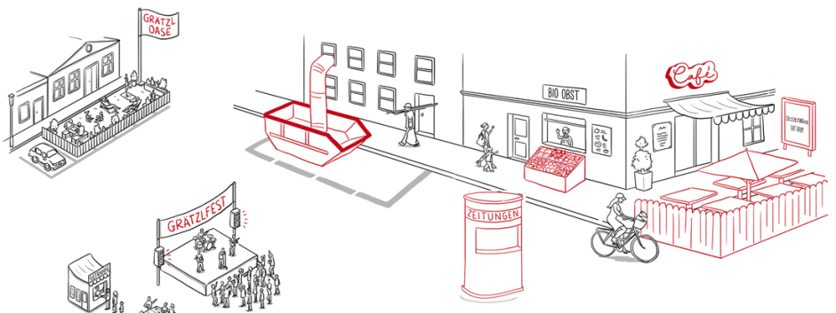
Project „Sharing Public Spaces“
Public spaces and streets are photographed by camera cars
Image data can be used by departments of the Vienna City Administration (Q3/2018)
Main Goal: Less on-site inspections during official procedures
Construction site
Pavement café
Billboard
Neighbourhood parties
Explanation video link

Slide 35
DigitalCity.Wien
Started in 2014 as an independent initiative of the administration of Vienna & committed IT companies
Raise public awareness in the importance of IT in Vienna
Main Projects 2016: education initiative, women in IT, etc…
Digitalcity.wien/

Slide 36
Questions? E-mail us!
post-pikt@md-os.wien.gv.at

Slide 37
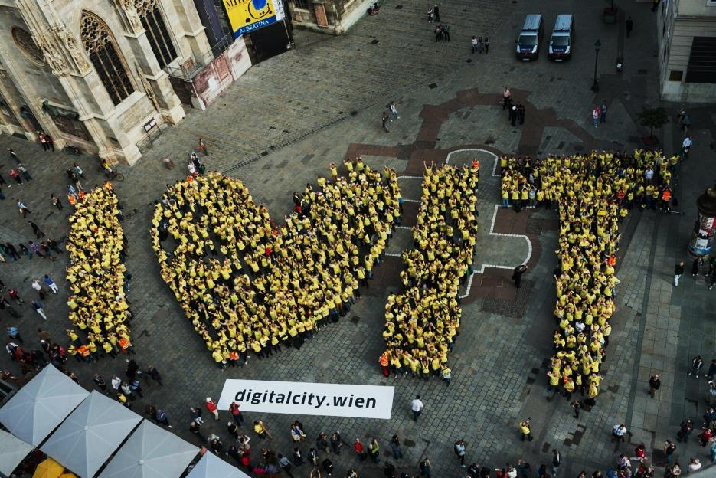
Thank you for your attention!

