Slide 1

Digital Transformation of Sofia – Challenges, Lessons and Results
Sofia Investment Agency
June, 2019

Slide 2


Sofia Economy at a Glance
1.65 M
population
incl. surrounding region
40%
of Bulgaria’s
GDP
25%
of Bulgaria’s
workforce
BBB-
positive outlook
S&P Credit Rating of Sofia
Notes:
POPULATION incl. surrounding region, out of 7.05 M

Slide 3
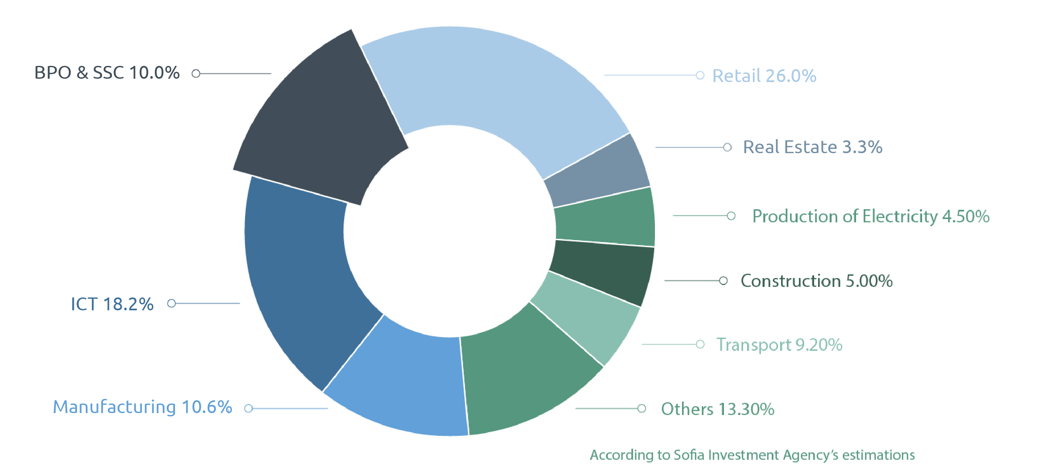
Sofia economy by sector, %*
*Value added at factor costs
Source: Sofia Economic and Investment Profile, 2018

Slide 4

Why Digitalisation?
Fulfill the role of the city as market creator
Increase efficiency
Fight negative demographic trends
Improve services for citizens and business
Prepare for smart city solutions
Make data-driven decisions

Slide 5
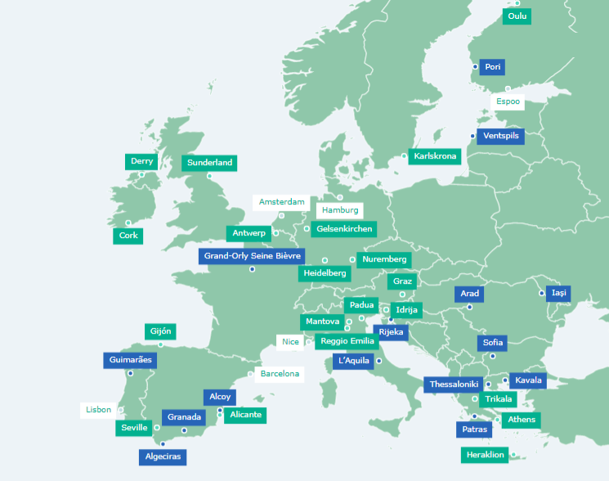
Digital Cities Challenge
Project of the European Commission
EC methodology
18 months consultancy for 15 cities including Sofia
6 mentor cities, 20 paid participants
Notes:
EC methodology – explained on next slide
Some participants: Amsterdam, Lisbon, Nice, Seville, Athens, Hamburg, Thessaloniki, Heidelberg, Antwerp, Nuremberg
On the picture: blue – free participants, green – paid participants, white – mentors

Slide 6

Digital Cities Challenge – Methodology
Step 1: Assessment of Sofia’s digital maturity
Step 2: Development of the Strategy for Digital Transformation for Sofia
Step 3: Development of models for governance, monitoring and evaluation of the Strategy
Academy seminars
Involved over 100 local stakeholders – interviews and workshops
Notes:
Everything done together with and under the supervision of experts – consultants of Sofia appointed by EC, local stakeholders, the consultancy company organising the project, other participating cities

Slide 7

Step 1: Assessment of Sofia’s digital maturity
Strong ICT sector – close to 20% of Sofia’s economy. But… export-oriented
Lack of common vision and coordination between digital projects in the city
Lack of an established system for data management on a city level
Low digital maturity of administration and industry

Slide 8
Step 1: Assessment of Sofia’s digital maturity

Slide 9
Step 1: Assessment of Sofia’s digital maturity

Slide 10

Step 2: The Strategy for Digital Transformation
Notes:
Talk about the city becoming a customer and a test ground for local ICT companies
4 priority areas: e-government, utilities, transport, startup ecosystem
14 specific activities for developing the priority areas

Slide 11


Step 3: Models for Governance, Monitoring and Evaluation
Governance
  Sofia Investment Agency
  Advisory boards
  Sofia Digital Agency
  Chief Digital Officer
Monitoring and evaluation
  Different levels of KPIs
Notes:
Governance: initially by Sofia Investment Agency with the help of advisory boards. Advisory boards: important to have all 5 stakeholder groups represented in the DTSS governance: industry, academia, administration, users (groups and organisations, representing the citizens), experts in sustainable development of environment and use of natural resources
Suggested new governance: Sofia Digital Agency takes over the management instead of Sofia Investment Agency, again with the help with advisory boards
Chief Digital Officer - Establish a system for data management; Establish the policies and practices that ensure data is collected, stored, analysed and shared consistently
Different levels of key performance indicators to be monitored in the following years by the management team

Slide 12


Digital Cities Challenge – Results so far
Community with over 40 EU cities
Community with over 100 local stakeholders
Create a point of contact for digital projects in Sofia
Invitations to participate in other projects
Increased awareness about the need for digitalisation
Working on submitting the Strategy for review and vote by the Sofia Municipal Council

Slide 13



Sofia Investment Agency
12 Gen. Gourko St,
Sofia, Bulgaria
contact@investsofia.com
investsofia.com
Sofia Investment Agency
@InvestSofia
/SofiaInvestmentAgency

