Slide 1
Changing the paradigm in
Filip Húšťava
Data policy department

Slide 2
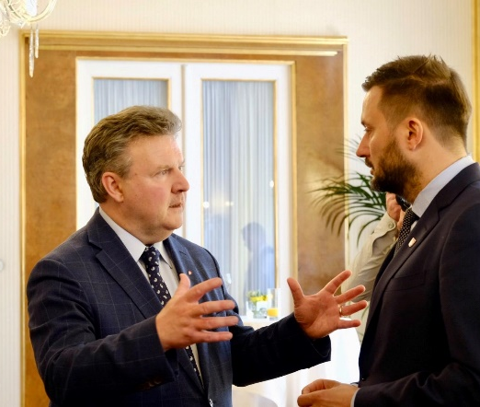
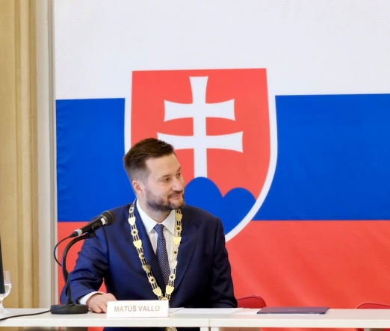
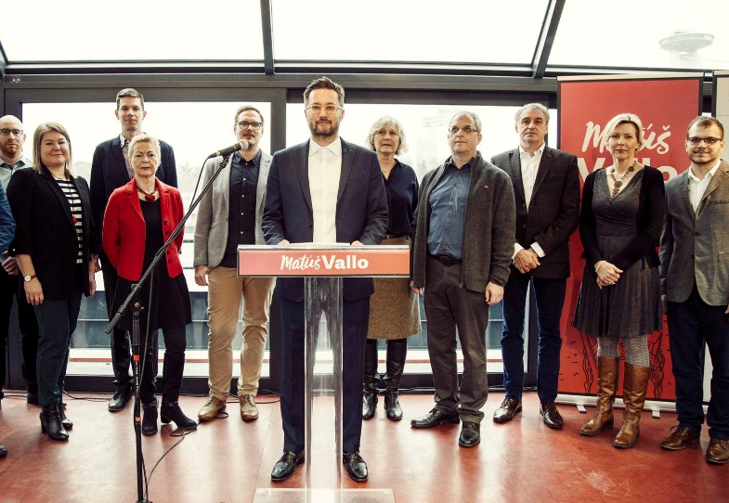
Bratislava today
New mayor from 12/2018 city acitivist, architect, musician Ing. arch. Matúš Vallo
Plan Bratislava
Team Vallo in city parliament
New view on public service
Open style of communication

Slide 3
Bratislava today
Significant transportation projects in progress
Challenges in coordination with city districts parliaments
Transforming city administration
Changing the nomination process to leading positions in city companies

Slide 4
Bratislava on the way to the future
AI – considering deployment in sustainability and land mapping projects, pilot project – traffic camera measuring
Blockchain technology – App for Regional Integrated Transportation
Reviving of Bratislava City Card
Preparing city app – communication and participation
Adopting best practices from other cities

Slide 5
Bratislava on the way to the future
Cities Coalition on Digital Rights
first international promise/framework for future decisions
Joined in 04/2019

Slide 6
Bratislava in (2030) the future
Open – opendata, transparency
Smart – processes, technology
Cooperative – serve/cooperate with stakeholders not govern them
ECO, citizens, other cultures – friendly city good for living

Slide 7
Verím, že dokážeme
spoločne zmeniť Bratislavu
I believe we can change Bratislava
together
Notes:
toto musi byt jemnejsie, vsak ze emocia - nedavaj to prosim nakrivo

Slide 8
Thank you for your attention ... filip.hustava@bratislava.sk

